Slide 1
Photomicrographs of Plant foods
Fig
Permission to reproduce original photomicrographs used to make this collection may be obtained from
Dr. David O. Norris at
david.norris@colorado.edu

Slide 2
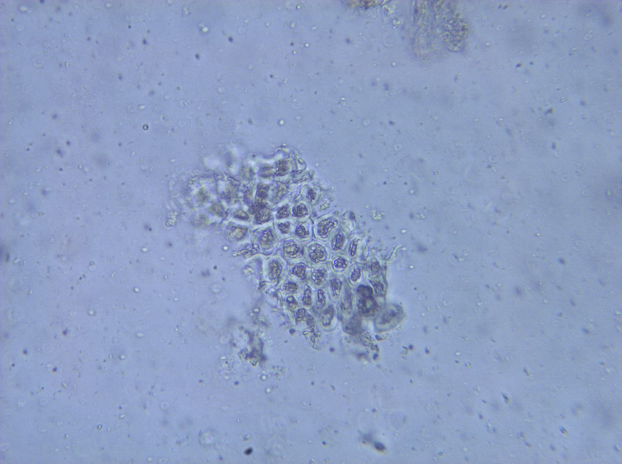
Notes:
193. Ficus carica L. Fig. Skin epidermal fragment, 25X.

Slide 3
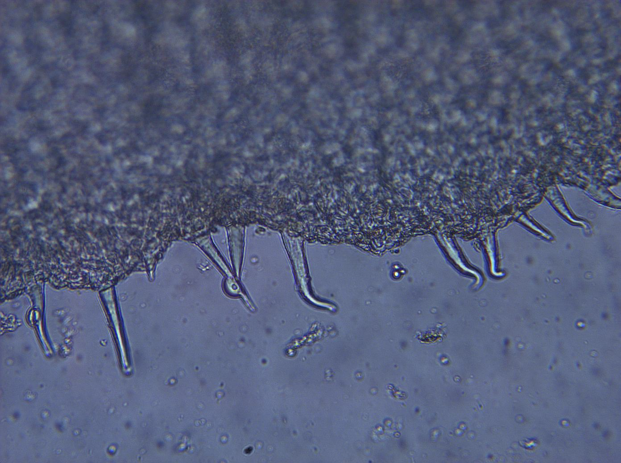
Notes:
194. Fig. Skin epidermal surface with small, simple trichomes (arrows), 25X.

Slide 4
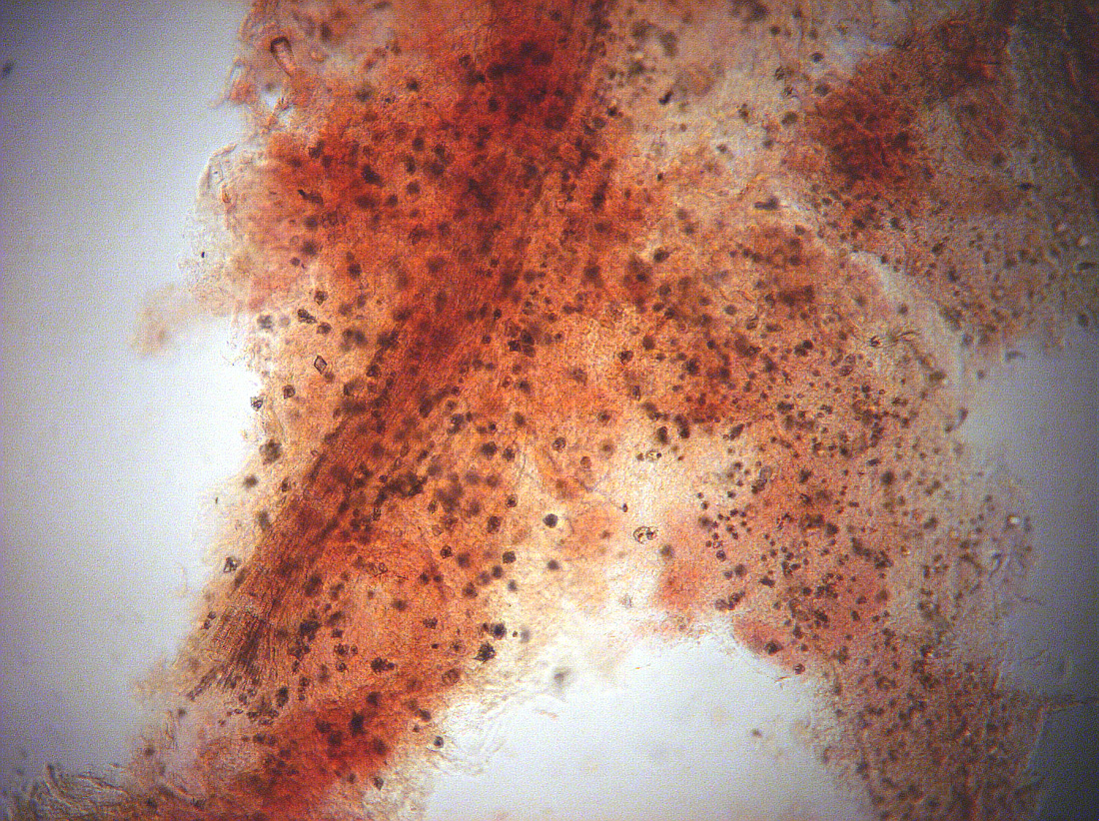
Notes:
195. Fig. Pulp with vascular tissue (white arrows) and abundant small druse crystals (black arrows), 4X.

Slide 5
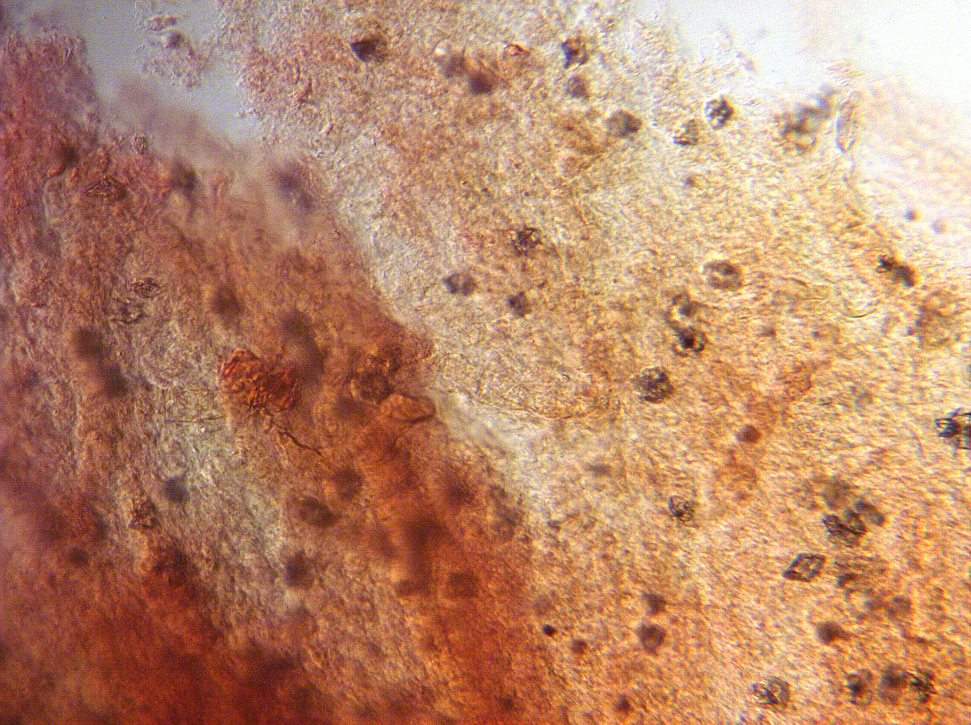
Notes:
196. Fig. Pulp with many druse crystals (arrows), 10X.

